Slide 1
Craggier National Park
By Jack & Andrew

Slide 2
Problem Statement
Craggier National Park is a South African game reserve offering international hunters trophy-hunting opportunities
In the park there is a limited amount of food resources split into three categories: bulk (250 AU), concentrate (150 AU) and browse (100 AU)
Each species of animal on the reserve has a preferred ratio of each source of graze
Each species has a certain revenue that it brings in
Currently Craggier National park offers three different hunting packages
Management is looking to find the optimal mix of their current packages

Slide 3
Problem Statement Continued
Additionally, CNP wants to develop new packages to take advantage of possible wasted food resources
The park has requirements to keep the reserve running smoothly including limits on total hunting days and the types of hunting packages that can be offered
A solution will be one that maximizes the total revenue of the park, while abiding by the resource constraints and park requirements.

Slide 4
Assumptions
The 150 hunting days allowed, along with the 2 trophies per day only applies a constraint of 300 on the total annual trophies and does not affect the model formulation in other ways.
Assumed the current packages in the case refers to the three given packages in exhibit 3, without any packages for class 1.
Assumed the given exhibit 3 is not correct about elephant amount and warthog amount (should be 1 warthog and 0 elephant instead since there should be none of the big 3 in class 4)

Slide 5
Base Model
Since all the packages are given.
Decision variables are the number of each packages vi where i is 1-3. Let bj, cj and brj be the bulk, concentrate, browse rate for j from1-15
The constraints would be:
Class quantity st: v1 + v2 < 10, v3 < 8, total amount constraint: <= 300
AU constraint: set the total au for bulk, concentrate, and browse less or equal than 250, 150, and 100.
Objective function would be max the total revenue

Slide 6
Findings current packages
With sample packages 1,2 and 3 the IP model gives a solution of:
0 x package 1
10 x package 2
8 x package 3
The total revenue for this combination of packages is $76,875

Slide 7
Solution Approach
Our solution approach was to apply the column generation method to the problem.
The master problem would solve an LP to choose which packages to offer out of the available ones
The secondary problem would find a new package using the shadow prices of the master problem in a new LP formulation
Unfortunately we were unable to apply the column generation method and therefore we were unable to add new packages to the solution. (Both of us have a class conflict with 3-5 Monday and were unable to attend the tutorial)

Slide 8
Solution Approach Continued
The issue we had was applying the shadow prices of the master problem to the secondary problem
In the main problem there are 6 constraints and 15 options for a package. In column generation the shadow prices need to apply directly to the objective of the secondary problem and since we had no constraints related to each specific option we couldn’t find a way to fit them into the secondary objective function.
There may be a way to apply column generation to this problem, but we were unable to do it. Without it, the problem is much too complicated to solve effectively.

Slide 9
Alternative Approach
Instead of using the column generation method, we decided to apply GRG nonlinear models to solve the case by adding 4 packages named 4,5,6,7 each representing the best combination in class 1,2,3,4. The new decision variables are the row of value of each package and the 4 new columns of number of animals in each package. This method generates ideally the highest number of revenue of 172411. The new cuts and number of packages are as follows:

Slide 10
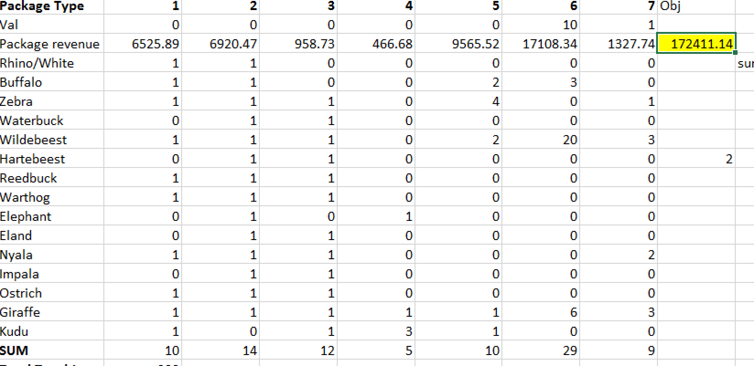

Slide 11
Alternative Approach Cont’d
The total trophies are: 299
The bulk au is 124.7/250
The concentrate au is 149.6/150
The browse au is 99.8/100

Slide 12
Sensitivity Analysis
Since our model suggested bulk graze is not fully used, what if the park modified the graze area for bulk, concentrate, and browse with a new value of 200,180, 120
The new max revenue will be 172788, increased by a very little amount.
If no graze limit is set,only the total of 500 is applied, the maximum revenue is 177108, increased by 2.7%, however the total graze area used will increase a lot, so it’s not worth it

Slide 13
Conclusion
If only use the current packages, the best solution is to get 0 package 1, 10 package 2, and 8 package 3, with a total revenue of 76,875
If animal diversity isn’t considered by the park, the optimal revenue would be 172411 by creating 1 class 3 and 1 class 4 package each with a value of 10 and 1.
No graze area changing is recommended

